Slide 1
Your Organisation Name xxx NOD Cataract Audit
© The Royal College of Ophthalmologists 2024. All rights reserved.
For permission to reproduce any of the content contained herein please contact contact@rcophth.ac.uk

Slide 2
Individual Surgeon’s access to NOD data
Insert screenshot or video to capture accessing NOD data via login

Slide 3
Part 1: Capturing the data for Cataract Audit

Slide 4
How are we doing recording data and getting feedback after surgery ?
There are two metrics to measure how well you are doing recording data for audit:
Case ascertainment (is the number of cataract operations for which audit data is available compared to the total done in your centre )
VA data before and after surgery – of operations recorded, what % have VA data before and after

Slide 5
Case Ascertainment
Of cataract operations reported to have been performed by your centre in 2022-23 (on NHS Data or DHSW), you have audit data on XX%**
**Some shortfall is common due to exclusion of ineligible cases (eg traumatic cataract, polar cataracts, combined procedures).
Case ascertainment %*
2018 | 2019 | 2020 | 2021 | 2022
Notes:
Appendix K has the data for your centre and overall
Appendix Q has the previous 5 years case ascertainment for your centre and overall
If your case ascertainment is 100% then this may be due to a time lag in reporting to NHS Digital and DHCW (so you report more cases to the NOD than you have to NHS Data/DHCW).
If you are noticing a large deficit in case ascertainment there can be other reasons for this. Some centres have gone through mergers and do not have the EMR on all sites yet. Some centres on paper based notes who are submitting via an excel spreadsheet, do not supply data for all operations for various reasons.

Slide 6
Valid Preoperative VA data recorded
National preoperative VA recording = 86.5%
Your centre proportion this year = XX%
2018 | 2019 | 2020 | 2021 | 2022
Notes:
Table 1 of the annual report gives national proportions
Data available in Appendix L (pre-op VA) for this year
Historic data for your centre is in Appendix S with VA data for past 5 years
To further understand your centre’s data capture on VA before and after surgery, Appendix U gives the % of eyes with VA data at different time points

Slide 7
Postoperative VA data breakdown 22-23
Ops eligible for postop VA results | % with postop VA data | Number of first treated eyes | % 1st eyes with postop VA data | Number of second treated eyes | % 2nd eyes with postop VA data
Notes:
Data available in Appendix L (post-op VA) and historic data for your centre is in Appendix S with VA data for the past 5 NHS years
To further understand your centres data capture on VA before and after surgery, Appendix U gives the % of eyes with VA data at different time points

Slide 8
Valid Postoperative VA data recorded
National proportion for 22/23 audit year = 69.0%
Your centre proportion this year = XX%
2018 | 2019 | 2020 | 2021 | 2022
Notes:
Table 1 of the annual report gives national proportions and more details
Data available in Appendix L and historic data for your centre is in Appendix S with VA data for the past 5 years (including this year so you could just pull the table from appendix S)
To further understand your centres data capture on VA before and after surgery, Appendix U gives the % of eyes with VA data at different time points

Slide 9
Valid data to report change in VA between pre- and post-op visits
National proportion for 22/23 audit year = 64.4%
Your centre proportion this year = XX%
Number of eligible Ops | % with preop VA data | Number eligible for postop VA results | % with postop VA data | % with change in VA data
Notes:
Table 1 of the annual report gives national proportions and more details
Your local data on VA change is available in Appendix L (and Appendix M gives you the postop data broken down for 1st and 2nd eyes)
The number of operations eligible for postop VA results is lower than the total operations done, because the eyes operated in the last few weeks of the audit year, have not had sufficient time to gather post operative VA data by the time the data is submitted to the NOD. As of 2024, the data submissions will be later in the year to allow more of the later operations in an audit year to have follow up data recorded. This will also allow postoperative results to be produced for the complete audit year instead of excluding operations from February and March.

Slide 10
Action points
Action points to improve data collection?
Notes:
Action points may be developed in discussion during audit meetings.

Slide 11
Part 2: Complications

Slide 12
Vision Loss
Vision Loss is loss of ≥0.3 LogMAR pre- to post-op
National Comparison Vision Loss rate = 0.90%
Your centre’s adjusted Vision Loss rate = XX%
2018 | 2019 | 2020 | 2021 | 2022
Notes:
Data available in appendix N & five-year data for your centre in Appendix T or behind the login at www.nodaudit.org.uk
For clarity – it could be communicated that the Vision Loss definition includes the following:
• For eyes with a preoperative VA of <1.00 LogMAR, a loss of ≥0.30 LogMAR (doubling or worse of
the visual angle) between the preoperative and postoperative VA measurements
• For eyes with a preoperative VA of ≥1.00 LogMAR and <CF, Vision Loss is designated if the
postoperative VA is HM, PL or NPL
• For eyes with a preoperative VA of CF, Vision Loss is designated if the postoperative VA is PL or NPL
• For eyes with a preoperative VA of HM, Vision Loss is designated if the postoperative VA is NPL
• For eyes with a preoperative VA of PL or NPL no Vision Loss is considered

Slide 13
Vision Loss
You can insert a picture of your centre’s Vision Loss from the NOD website here to show where you sit compared to all other centres
https://nodaudit.org.uk/data-and-reports/cataract-audit/adjusted-case-mix-visual-loss-funnel-plot-contributing-centres
Notes:
You need a login to access this data

Slide 14
Posterior Capsule Rupture is associated with:
20 x risk of a retinal detachment in the year following surgery
17 x risk of acute intra-operative supra-choroidal haemorrhage
16 x risk of losing ≥0.6 LogMAR from pre- to postoperatively
7 x risk of post-operative endophthalmitis
6x risk of losing ≥0.3 LogMAR from pre- to postoperatively
>2x risk of cystoid macular oedema
Notes:
>2x risk of Cystoid Macular Oedema
RCOphth NOD, Report 1: visual outcomes and complications.
Eye (Lond) 2015; 29(4): 552-60. Day AC, Donachie PH, Sparrow JM, Johnston RL.
7x risk of presumed infectious endophthalmitis
RCOphth NOD, Report 10: Risk factors for post-cataract surgery endophthalmitis.
Accepted for publication: Ophthalmology, May 2023. Liying Low, Vishal Shah, Charlotte FE Norridge, Paul HJ Donachie, John C Buchan
20x risk of retinal detachment in 1st postoperative year
RCOphth NOD, Report 3: Pseudophakic Retinal Detachment. Ophthalmology 2016; 123(8): 1711-5. Day AC, Donachie PHJ, Sparrow JM, Johnston RL.
16x increase risk of severe vision loss when (absolute risk of 3.1% risk of severe visual loss (loss of 0.6LogMAR or more) when PCR occurs compared to baseline UK risk of SVL of 0.2% (NOD paper submitted for publication)

Slide 15
Posterior Capsule Rupture (PCR) defined as:
“Posterior capsule rupture with or without vitreous prolapse, or zonule rupture with vitreous prolapse”
National unadjusted PCR rate = 0.79%
Your centre unadjusted PCR rate = XX %
Your centre PCR rate adjusted for case complexity = XX %
Notes:
Table 1 in the main report gives the national rates
Data available in appendix N & five-year data for your centre is in Appendix T or behind the login at www.nodaudit.org.uk

Slide 16
PCR rate
You can insert a picture of your centre’s PCR rate from the NOD website here to show where you sit compared to all other centres
https://nodaudit.org.uk/data-and-reports/cataract-audit/adjusted-case-mix-pcr-funnel-plot-contributing-centres
Notes:
You need a login to access this data

Slide 17
UK NOD Trends in PCR 2010/11 – 2022/23
 | NHS year (01 April to 31 March)
 | 2010 | 2011 | 2012 | 2013 | 2014 | 2015 | 2016 | 2017 | 2018 | 2019 | 2020 | 2021 | 2022
Centres | 42 | 49 | 50 | 54 | 58 | 71 | 93 | 103 | 113 | 125 | 135 | 162 | 177
Eligible operations | 68,107 | 83,460 | 102,440 | 121,779 | 135,924 | 152,761 | 193,189 | 218,454 | 249,311 | 283,442 | 176,398 | 377,366 | 481,530
% Case Ascertainment | - | - | - | - | - | - | 86.7 | 85.5 | 86.5 | 89.6 | 100.0 | 99.0 | 96.0
Unadjusted PCR rate (%) | 1.91 | 1.79 | 1.71 | 1.46 | 1.43 | 1.35 | 1.28 | 1.25 | 1.15 | 1.03 | 0.90 | 0.88 | 0.79
Notes:
five-year data for your centre is in Appendix T or you can create a longer series of annual results behind the login at www.nodaudit.org.uk

Slide 18
Your Centre PCR 2018/19 – 2022/23
2018 | 2019 | 2020 | 2021 | 2022
Notes:
five year data for your centre is in Appendix T or you can create a longer series of annual results behind the login at www.nodaudit.org.uk

Slide 19
Action points
Action points to reduce complications?
Notes:
Action points to improve postoperative data collection can be discussed during the audit meeting

Slide 20
Optional sections depending on local practice and audit priorities – delete or include as deemed appropriate

Slide 21
Part 3: Training

Slide 22
Contribution to training – national data
Many centres offer no training opportunities in 2022-23:
481,530 eligible operations performed by 2,312 surgeons
1,244 consultants performed 406,620 (84.4%) operations
217 career grade non-consultants did 19,397 (4.0%) operations
807 more experienced trainees did 49,615 (10.3%) operations
151 less experienced trainees did 5,898 (1.2%) operations
Notes:
Appendix O of the annual NOD report gives more detailed breakdown over the past 5 years

Slide 23
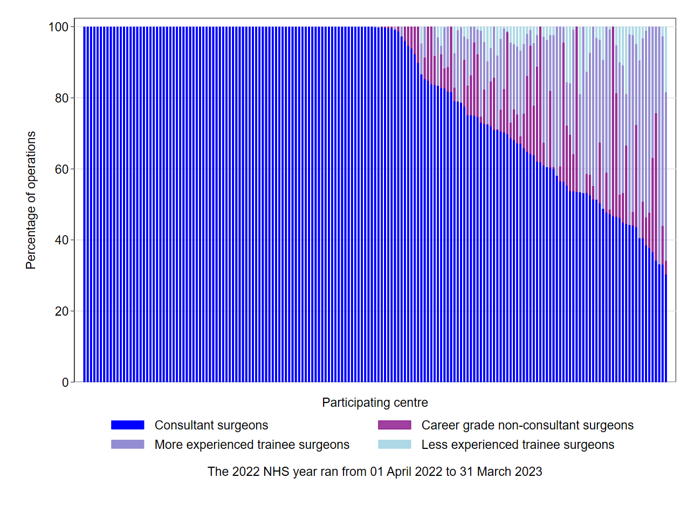
Contribution to training
Percentage of eligible operations performed by each grade of surgeon for each contributing centre – Ordered by the percentage of operations performed by consultant surgeons
Notes:
Each blue line is a centre. Around half of the centres offer zero training in cataract surgery

Slide 24
GMC 2022 National Training Survey
~600 STs
Proportion of trainees who had not completed 50 or more cases by end of their ST2:
12% in 2019
to 35% in 2022
Analysis of cataract training provision in england - (2022) RCOphhth. Available at: https://www.rcophth.ac.uk/wp-content/uploads/2022/10/Analysis-of-cataract-training-provision-in-England_v2.pdf (Accessed: 29 August 2023).

Slide 25
Your Centre 2022-23
Number of eligible operations | Number of surgeons | % cases by Consultants | % cases by career grade non-consultant | % cases by more experienced trainees | % cases by less experienced trainees
Notes:
Appendix K gives the percentage of operations for each surgeon grade from your centre

Slide 26
Action points
Action points to improve training opportunities?
Notes:
Action points to improve training opportunities or alternatively to get ST1-ST2 trained in ISTC locally (if the lowest complexity cases are being operated upon in centres currently not providing training to the least experienced surgeons)

Slide 27
Part 4: Immediate Sequential Bilateral Cataract Surgery (ISBCS)

Slide 28
ISBCS National Data – 2022-23
ISBCS was performed for 1,643 patients by 295 surgeons in 64 centres
A trainee surgeon performed 342 (19.7%) of the operations, and for 90 (5.5%) patients a trainee surgeon performed both eye operations
How many ISBCS did you perform?
Are ISBCS cases used in training?
Can this be expanded for the two groups identified by NICE who should be offered ISBCS?
Notes:
This is an optional section if you feel there is local interest in ISBCS (although it is recommend practice to offer ISBCS by NICE in NG77 which states:
10.2.7 Recommendation 34.
Offer second-eye cataract surgery using the same criteria as for the first-eye surgery (see section 6 for referral for cataract surgery). 35. Consider bilateral simultaneous cataract surgery for • people who are at low risk of ocular complications during and after surgery or • people who need to have general anaesthesia for cataract surgery but for whom general anaesthesia carries an increased risk of complications or distress.
The NOD reports overall figures, but we do not report the) number of ISBCS cases for centres (appendix P)

Slide 29
Part 4: Conclusions

Slide 30
Action points
Data collection action points – eg preop, postop, refractive, PROM
Complication reduction action points – eg case complexity scoring, kit/technology (I/A options (bimanual/silicone tipped))
Training action points – how to increase training opportunities whilst maintaining safety for patients?
ISBCS – eg formalisation of pathway

Slide 31
Thank you for supporting the RCOphth NOD www.nodaudit.org.uk
© The Royal College of Ophthalmologists 2024. All rights reserved.
For permission to reproduce any of the content contained herein please contact contact@rcophth.ac.uk

